Slide 1



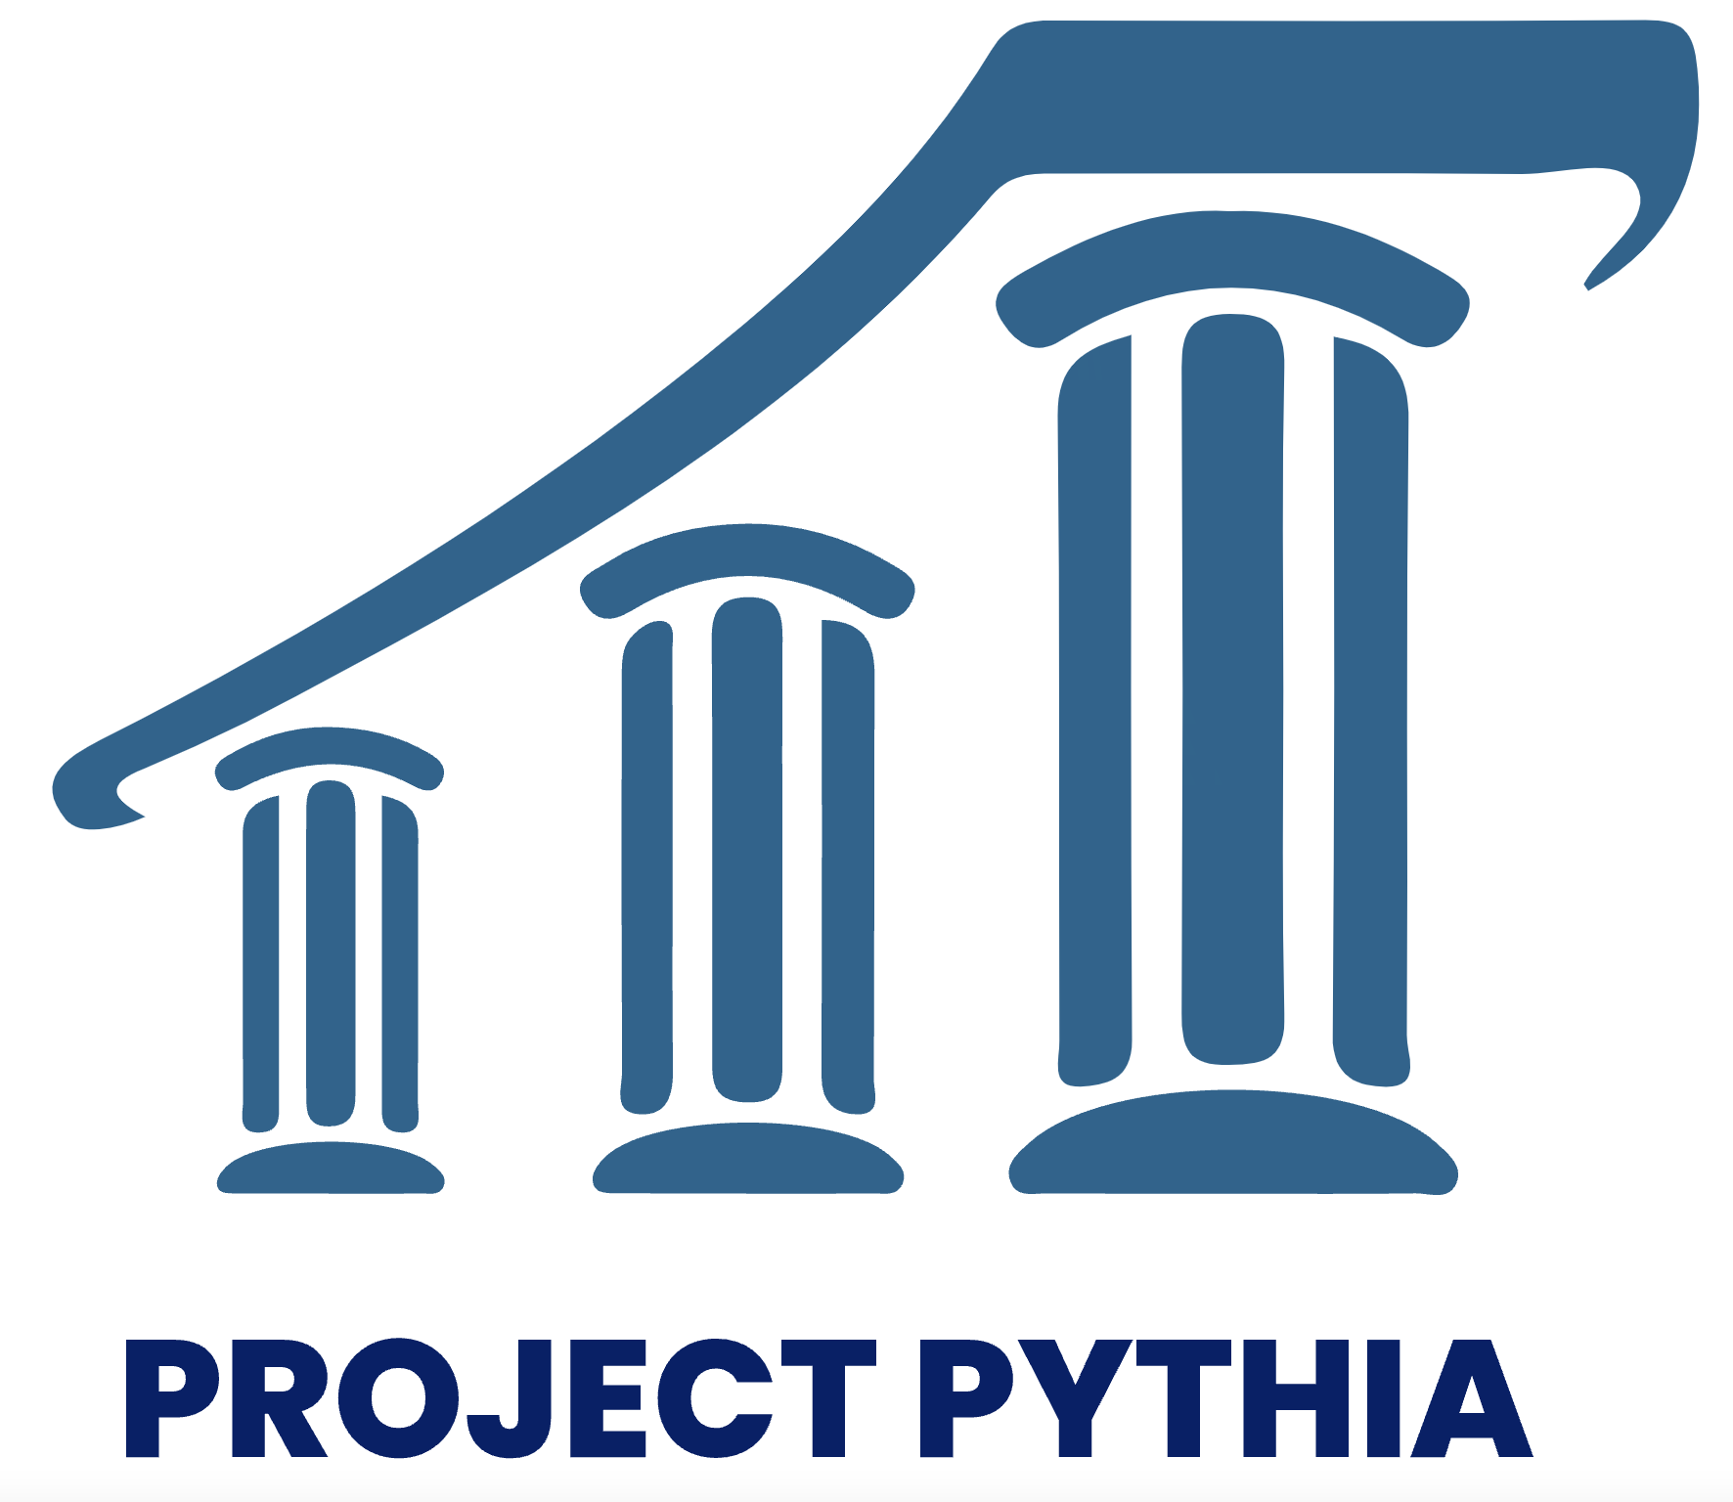

PROJECT PYTHIA Introduction: all about Pythia and Cookbooks
9 AUGUST 2023
Notes:
NOTE: Background image can be used as is or changed for a particular presentation. Click: Slide > Edit theme.

Slide 2
Project Pythia
what, why, where is it headed?

Slide 3
Project motivation
Geoscience community moving to open source software and cloud computing for analysis to better support open, reproducible science
Python ecosystem, cloud computing are complex and dynamic environments
Geoscientists are not computer scientists
Little training material exists that is focused specifically on needs of geoscientists

Slide 4
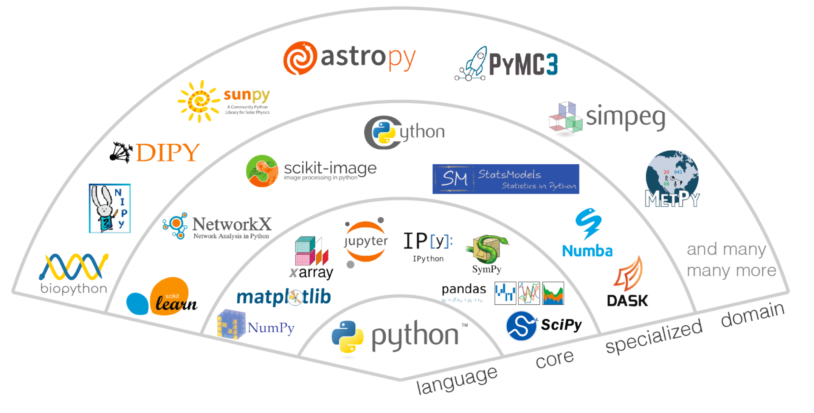
… but which package should I use?
Image credit: VanderPlas, 2017

Slide 5
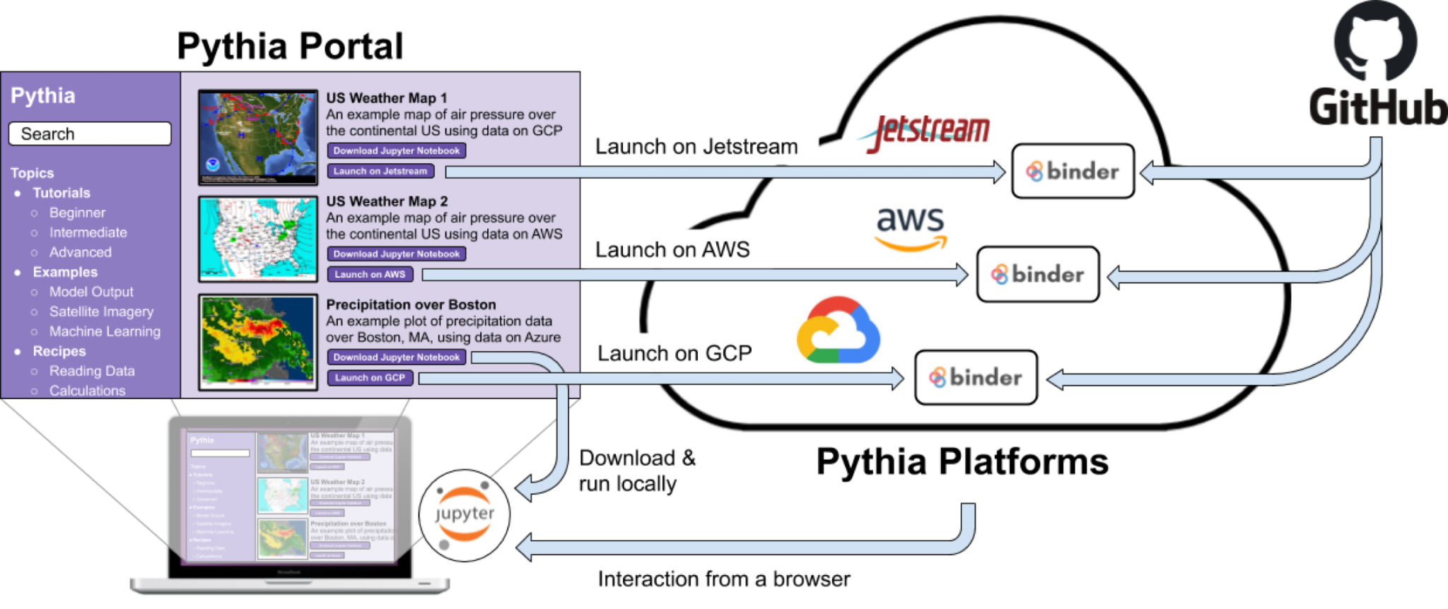
A Community Learning Resource for Geoscientists
The goto resource for learning the Scientific Python Ecosystem
Geoscience focused
From beginner to the power user
Tutorials, videos, examples, on-line courses, and sample data
Community owned

Slide 6
Why “Pythia”?
In ancient Greek mythology, the god Apollo is said to have slain the monstrous Python. Apollo’s temple was later served by the Oracle of Delphi, who was known as the Pythia.
Like the Oracle of old, Project Pythia will help you make sense of things that seem mysterious. We will not, however, slay your Python, but instead help you improve it – and help you to help others do the same!
https://projectpythia.org/about.html

Slide 7
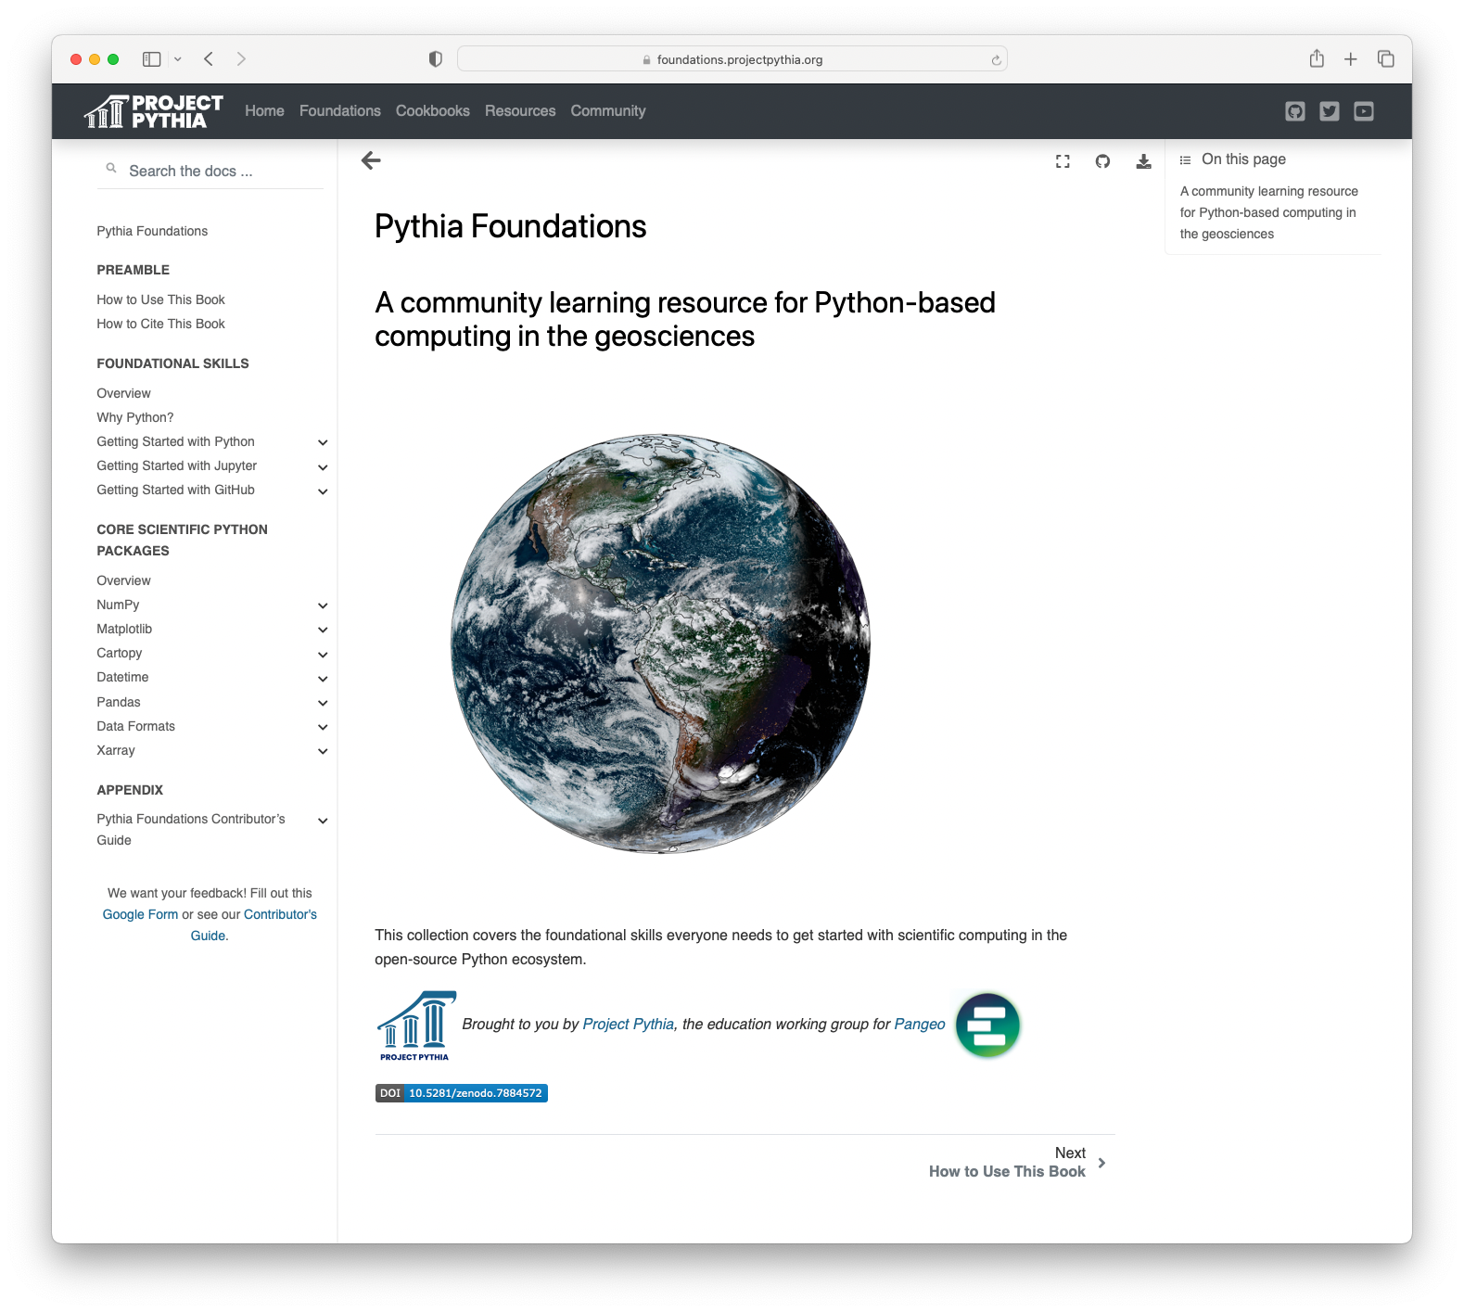
The Foundations book
https://foundations.projectpythia.org/
A comprehensive set of tutorials covering the foundational skills needed to get started with computing in the open-source Python ecosystem.
Serve as common references for more advanced and domain-specific Cookbooks
All tutorials are Binderized for exploratory learning

Slide 8
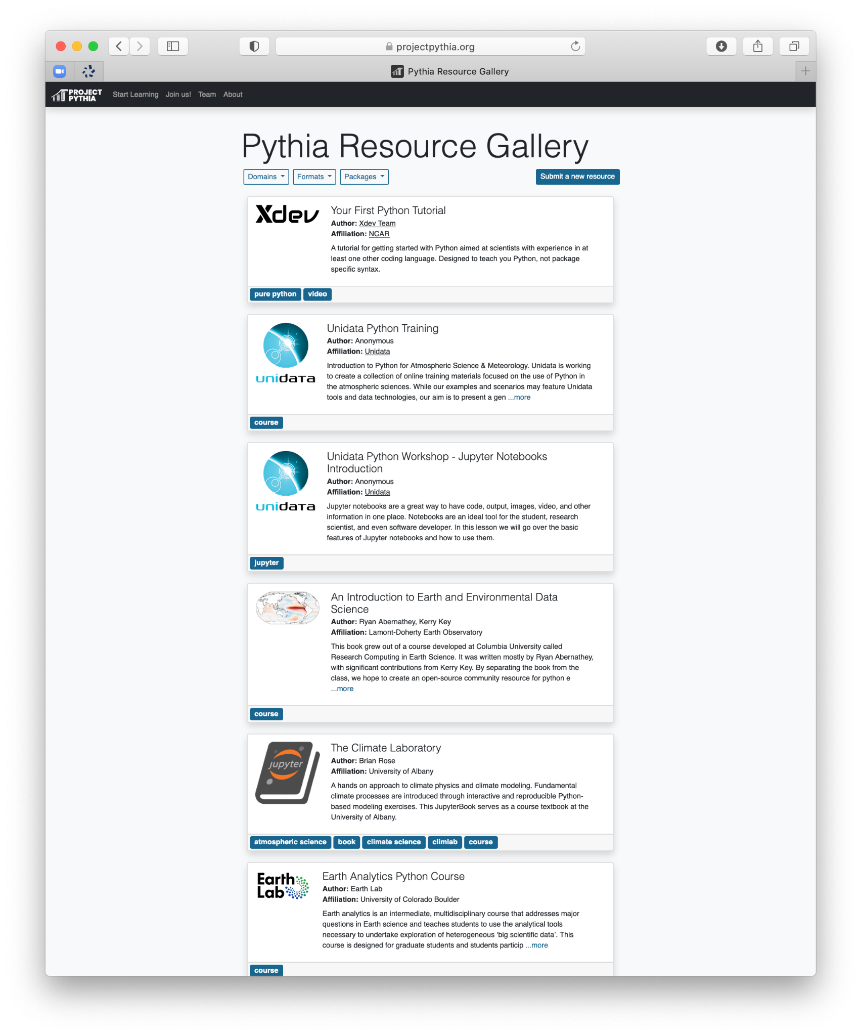
The Resource Gallery
https://projectpythia.org/resource-gallery.html
A curated, searchable, and extensible gallery of links to external learning resources
An attempt to “beat Google” by gathering together relevant resources for the geosciences

Slide 9
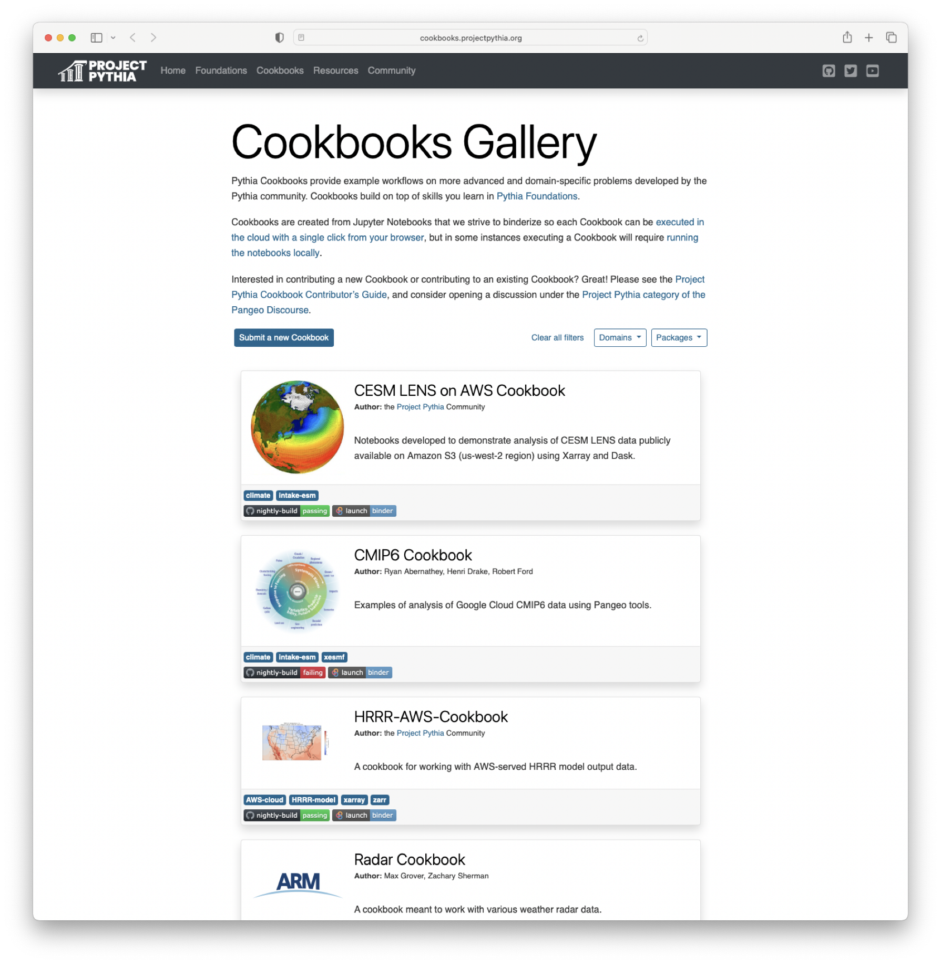
Pythia Cookbooks
https://cookbooks.projectpythia.org
Cookbooks are community-contributed collections of advanced or domain-specific tutorials and example workflows
Essential features of Pythia Cookbooks:
explicitly build upon Foundations
Demonstrate real workflows on publicly available data
Backed by automated testing infrastructure to ensure that the example code “just works” and stays relevant
Binderized for interactive learning
Cookbooks are meant to serve as starting points for new geoscience analysis using the Python stack

Slide 10
Why Cookbooks?
What problems are Cookbooks trying to solve?

Slide 11
What problems are Cookbooks trying to solve?
Jupyter Notebooks are awesome, but…
Ambiguity: Jupyter notebooks don’t fully describe their own execution environment
Obsolescence: most Notebooks found “in the wild” will not run and/or will not reproduce themselves
Collaboration: Notebooks don’t play very well with GitHub pull requests
Findable and Accessible: using Notebooks to share knowledge about scientific workflows requires an audience!
Scalability: tutorials that run in a limited sandbox don’t offer clearest paths to doing new science on real data

Slide 12


What problems are Cookbooks trying to solve?
Jupyter Notebooks are awesome, but…
Ambiguity: Jupyter notebooks don’t fully describe their own execution environment
A great tool for packaging Notebooks and conda environment descriptions into easy-to-navigate Web pages, with Binder links for execution

Slide 13

What problems are Cookbooks trying to solve?
Jupyter Notebooks are awesome, but…
Obsolescence: most Notebooks found “in the wild” will not run and/or will not reproduce themselves
We need a CI service that can perform regular “health-checking” of notebook code!

Slide 14

What problems are Cookbooks trying to solve?
Jupyter Notebooks are awesome, but…
Ambiguity: Jupyter notebooks don’t fully describe their own execution environment
Obsolescence: most Notebooks found “in the wild” will not run and/or will not reproduce themselves
Collaboration: Notebooks don’t play very well with GitHub pull requests
We need to execute notebooks and generate + deploy a preview of the rendered book to facilitate review and merge cycles

Slide 15
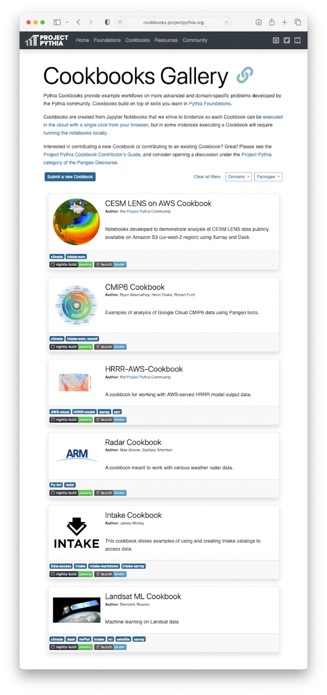
What problems are Cookbooks trying to solve?
Jupyter Notebooks are awesome, but…
Ambiguity: Jupyter notebooks don’t fully describe their own execution environment
Obsolescence: most Notebooks found “in the wild” will not run and/or will not reproduce themselves
Collaboration: Notebooks don’t play very well with GitHub pull requests
Findable and Accessible: using Notebooks to share knowledge about scientific workflows requires an audience!
We should have a community repository for sharing workflows! And it should be organized and filterable

Slide 16

What problems are Cookbooks trying to solve?
Jupyter Notebooks are awesome, but…
Ambiguity: Jupyter notebooks don’t fully describe their own execution environment
Obsolescence: most Notebooks found “in the wild” will not run and/or will not reproduce themselves
Collaboration: Notebooks don’t play very well with GitHub pull requests
Findable and Accessible: using Notebooks to share knowledge about scientific workflows requires an audience!
Scalability: tutorials that run in a limited sandbox don’t offer clearest paths to doing new science on real data
We need to be able to route notebook execution to the appropriate compute resource for its content!

Slide 17


Pythia Cookbooks, a complete pipeline for reproducible, self-publishing notebooks
Got a cool workflow to demonstrate?
Clone the Cookbook Template repo
Commit some unexecuted notebooks
Edit a short list of config files:
TOC for the book
URL for the appropriate BinderHub service
environment.yml for dependencies
Switch on GitHub pages for your repo
That’s it! Your Cookbook should build and publish itself, with previews for all PRs
Want to host your Cookbook on the Pythia Gallery?
Transfer the repo to the ProjectPythia org
Open a PR on the cookbook-gallery with some simple filter tags (or just reach out!)

Slide 18

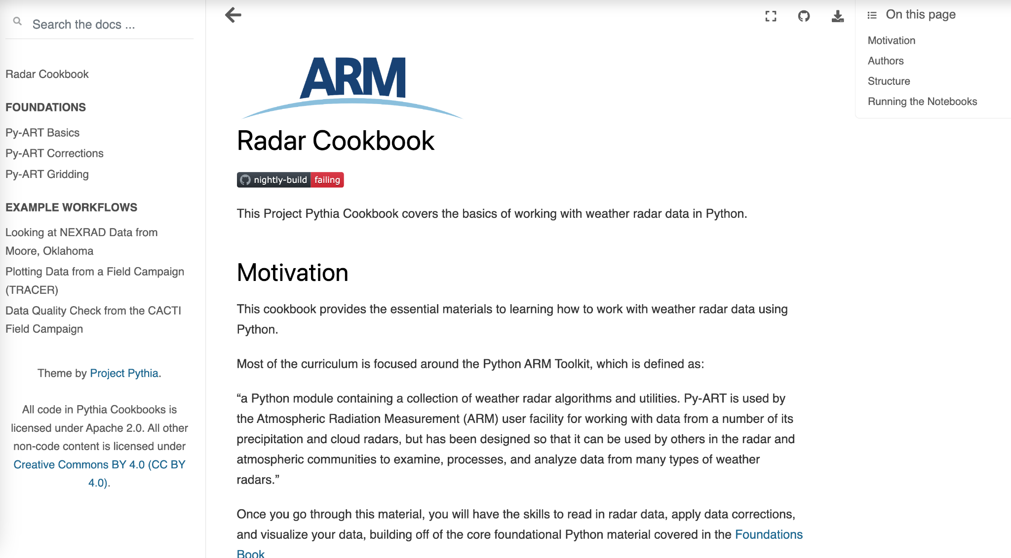
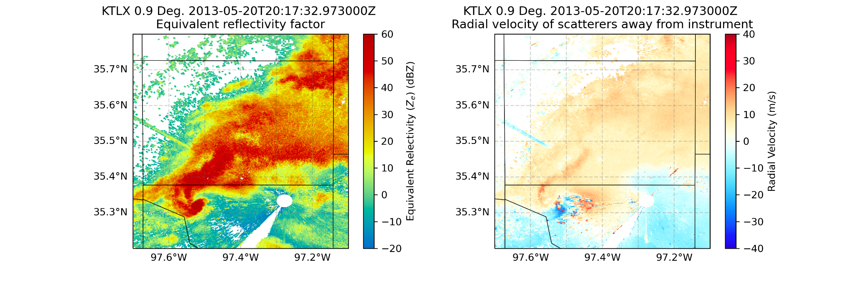


Radar Cookbook Improvements: Including the Rest of the Ecosystem
Notes:
An existing cookbook that we’re looking to improve. Currently focused on one tool (Py-ART), but we’d like to show more packages (RadLib, Xradar, etc ^^) relevant to radar data. Also fix failing build! https://projectpythia.org/radar-cookbook/README.html , migrating existing course content

Slide 19
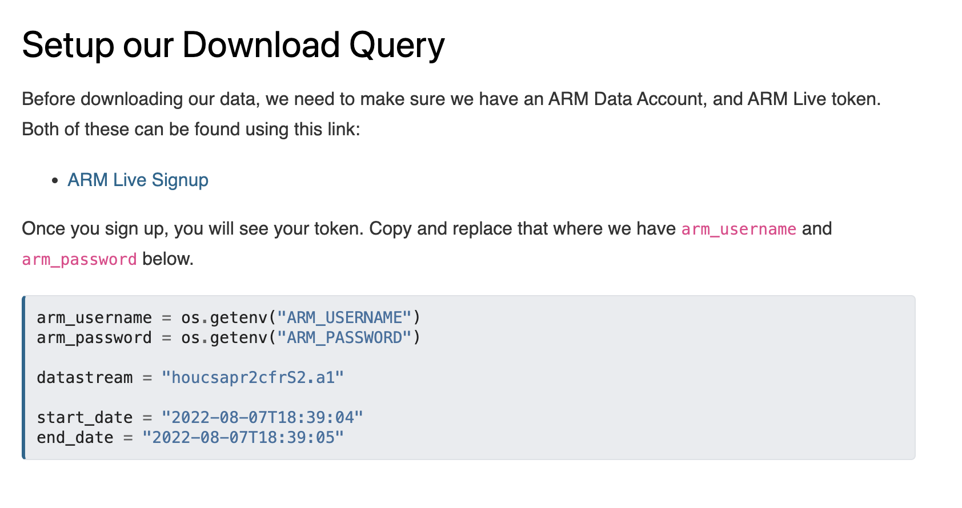
Example workflow – 2D objective analysis CSAPR2 RHI sweep

Slide 20
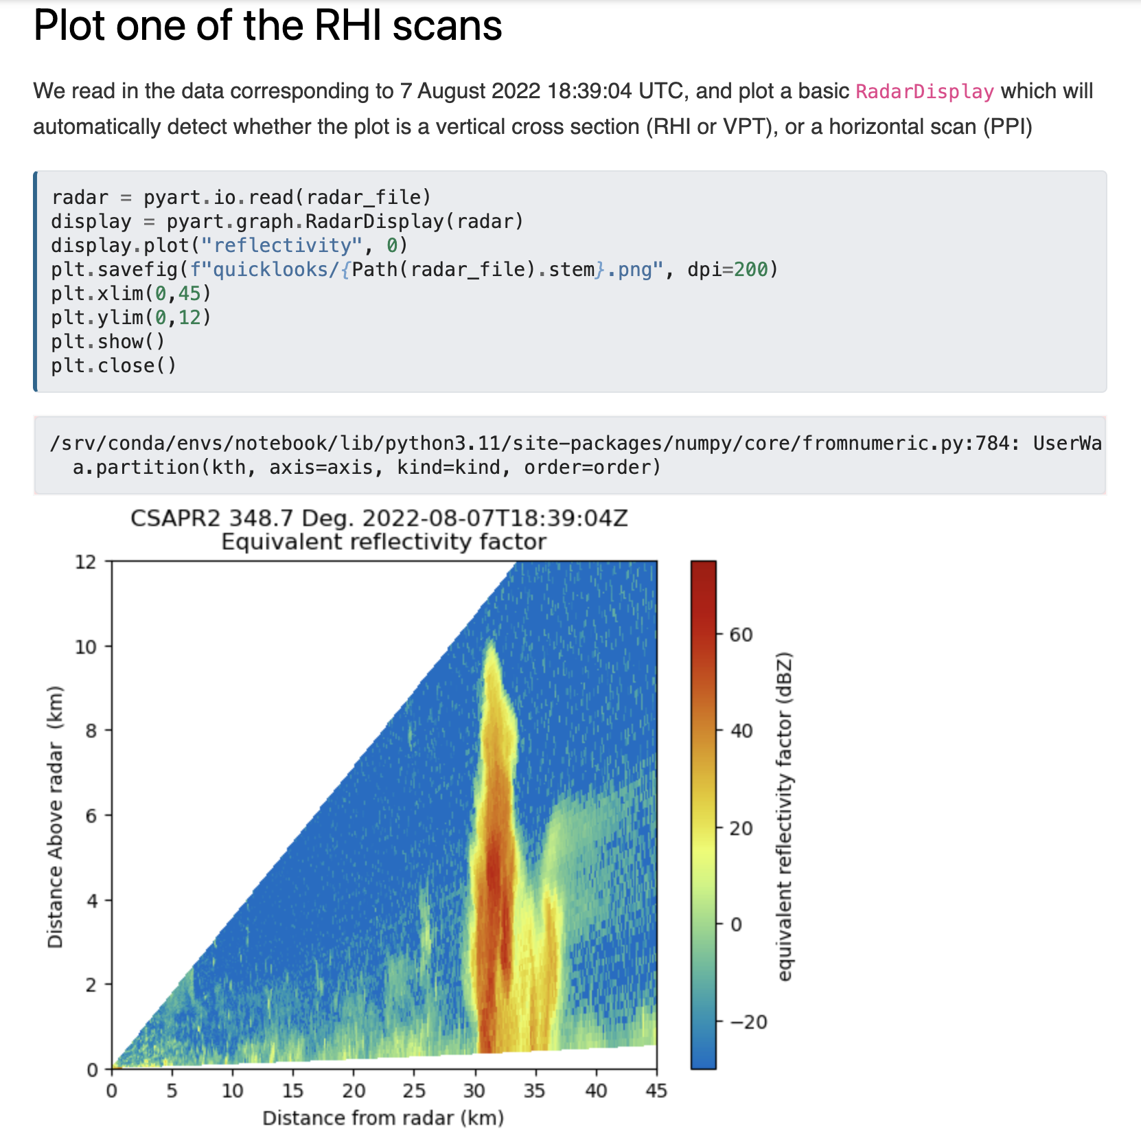

Slide 21
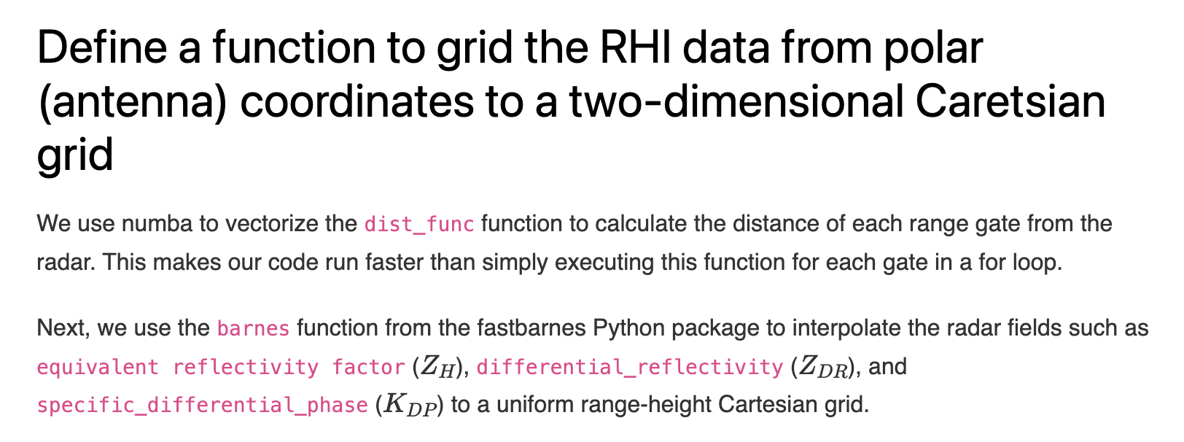

Slide 22
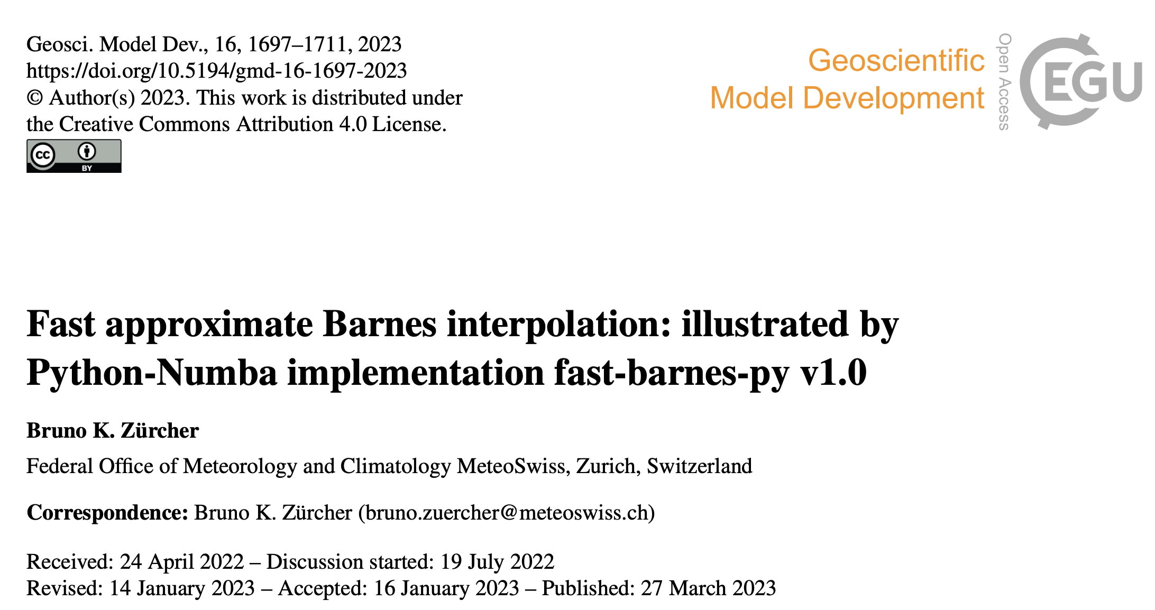
https://github.com/MeteoSwiss/fast-barnes-py

Slide 23
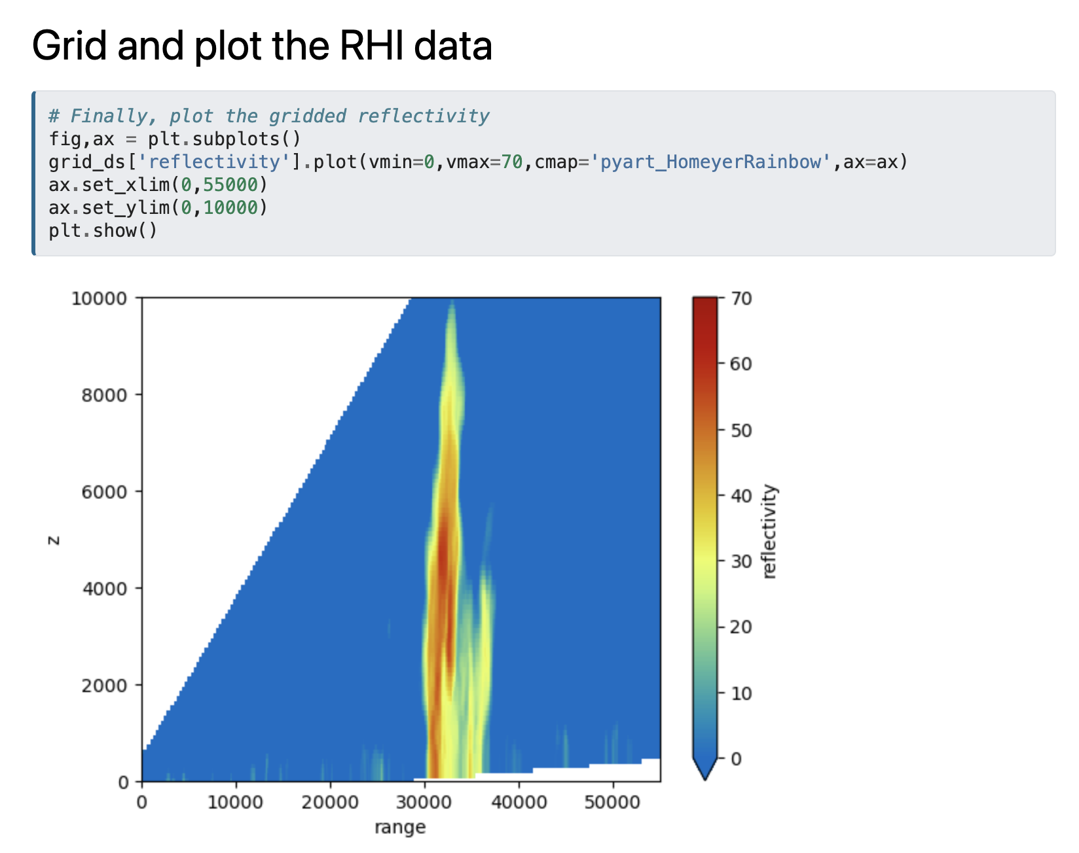

Slide 24
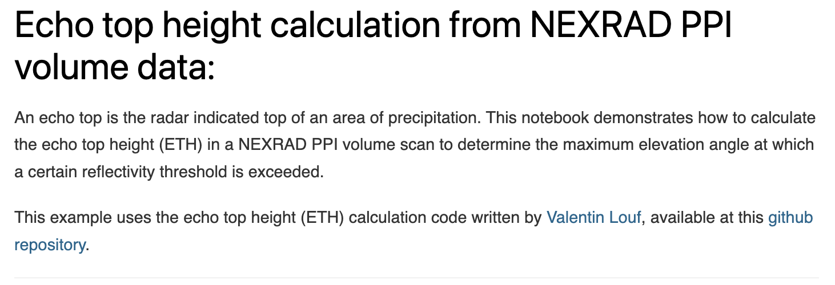
https://projectpythia.org/radar-cookbook/notebooks/example-workflows/echo_top_height.html

